Slide 1
DESIGN AND IMPLEMENTATION OF A DATABASE MANAGEMENT SYSTEM FOR HEALTH INSURANCE POLICY AND CLAIMS MANAGEMENT SYSTEM
Team & Course
Team members: [Anoushka Rojaria, Aaditi Chougule, Hansika Kommareddy]
Roll numbers: [2WU0101014, 2WU0101002, 2WU0101060]
Course: [DataBase Management Systems]
Faculty: [Dr. Kiran Mayee]

Slide 2
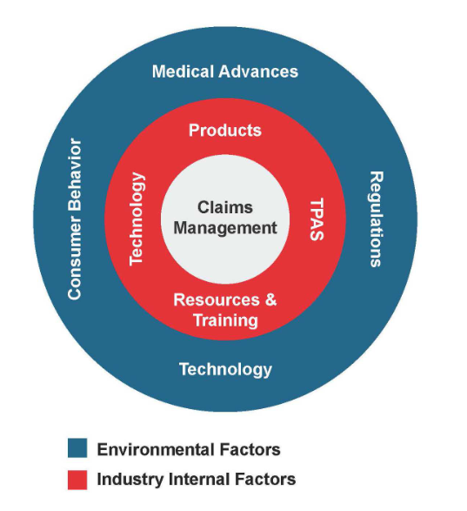
Problem Statement
Claim processing spans many entities and records
Manual workflows cause duplication & inconsistent records
Claims are difficult to track across stages
Need a centralized, auditable database
Intended users: Claim officers | Insurance admins | Customers

Slide 3

Objectives & Scope
Manage customers, policies, plans, treatments, premiums, claims
Maintain hospitals, documents, assessments, settlements, appeals
Enforce integrity via PK/FK, constraints & indexes
Generate operational & compliance reports
Provide explainable claim decisions (audit trail)

Slide 4
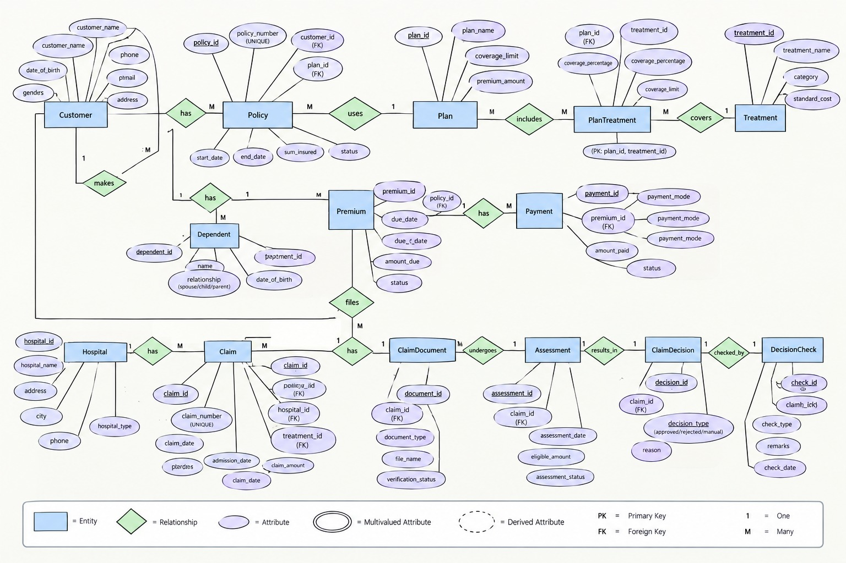
ER Diagram
Entities: Customer, Policy, Plan, Treatment, Hospital, Claim, etc.
Attributes, PKs and FKs labeled
Relationships: 1:N and M:N (e.g., Plan–Treatment via PlanTreatment)
Participation: total/partial noted for required relationships

Slide 5
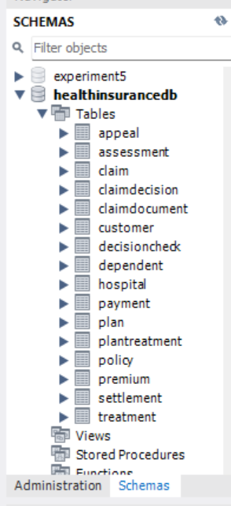
Schema & Normalization
16 tables: Customer, Plan, Treatment, PlanTreatment, Policy, Dependent, Premium, Payment
Tables continued: Hospital, Claim, ClaimDocument, Assessment, ClaimDecision, DecisionCheck, Settlement, Appeal
PKs, FKs, constraints, and indexes implemented
Example relations: Customer(CustomerID PK,...); Policy(PolicyID PK, CustomerID FK, PlanID FK,...); Claim(ClaimID PK, PolicyID FK, HospitalID FK,...)
Normalized to 3NF — PlanTreatment resolves M:N

Slide 6
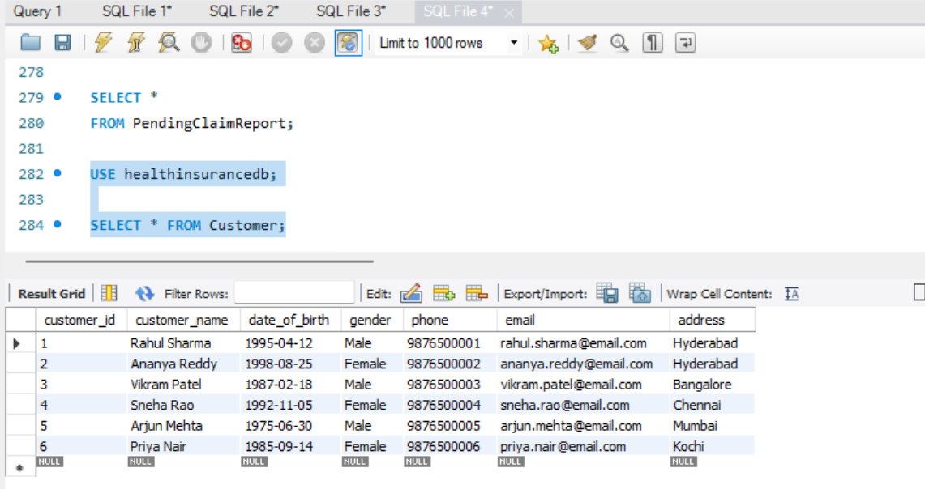
Database & Queries (Live Demo)
SELECT (JOIN)
Multi-table joins: Policy → Customer → Claim → Hospital
INSERT
Seed: 5+ records per table for demo
VIEWS & REPORTS
Prebuilt views for dashboards & compliance

Slide 7
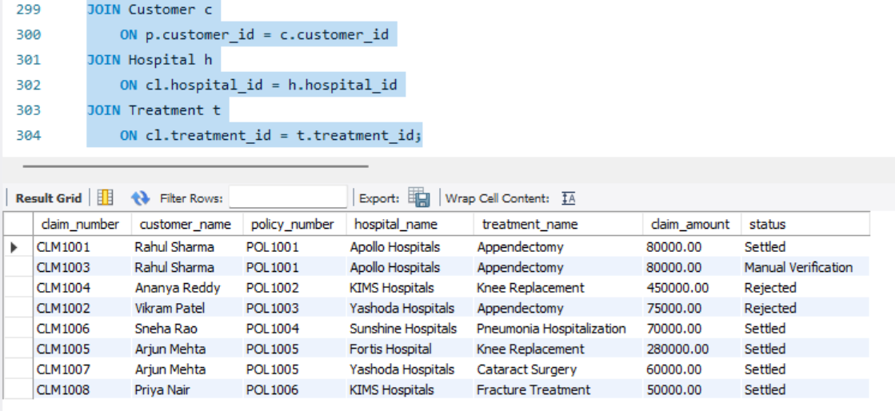
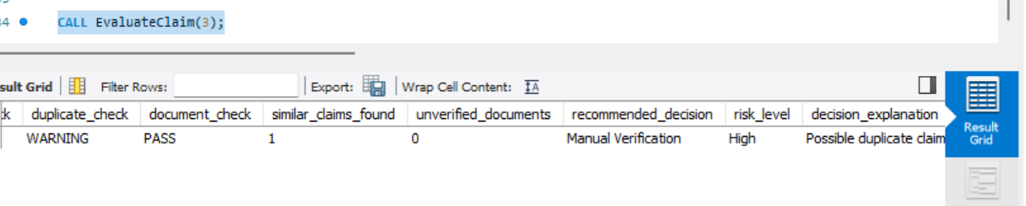
★ Explainable Claim Decision System
Flow: Claim → EvaluateClaim stored procedure → five checks → Decision
Checks: Policy validity | Treatment coverage | Coverage availability | Duplicate detection | Document verification
Outcomes: Approve / Manual Verification / Reject
Each outcome includes a human-readable explanation & audit trail

Slide 8
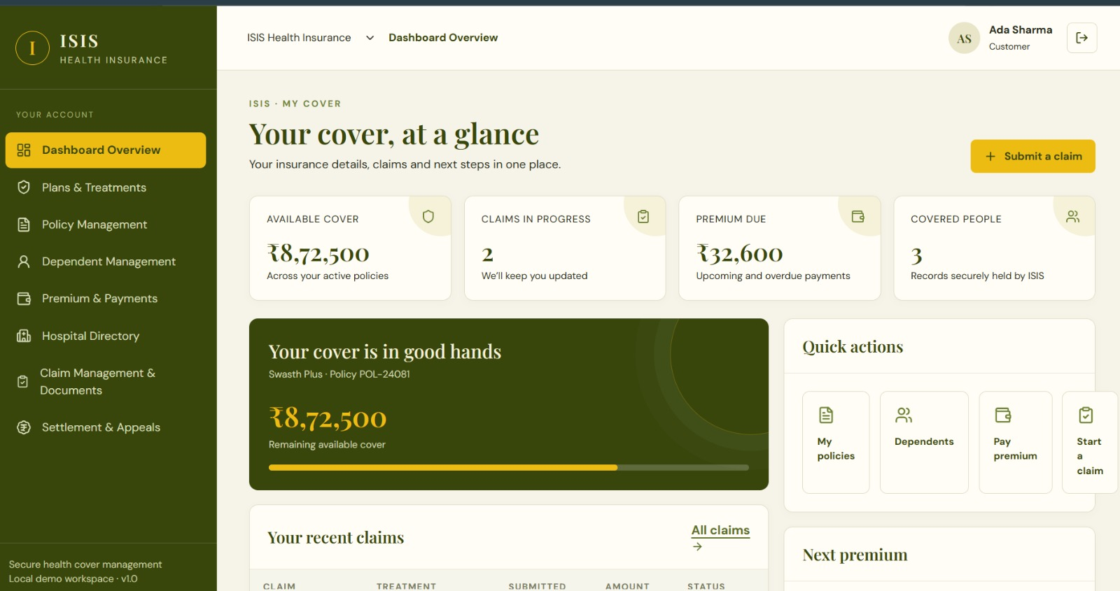
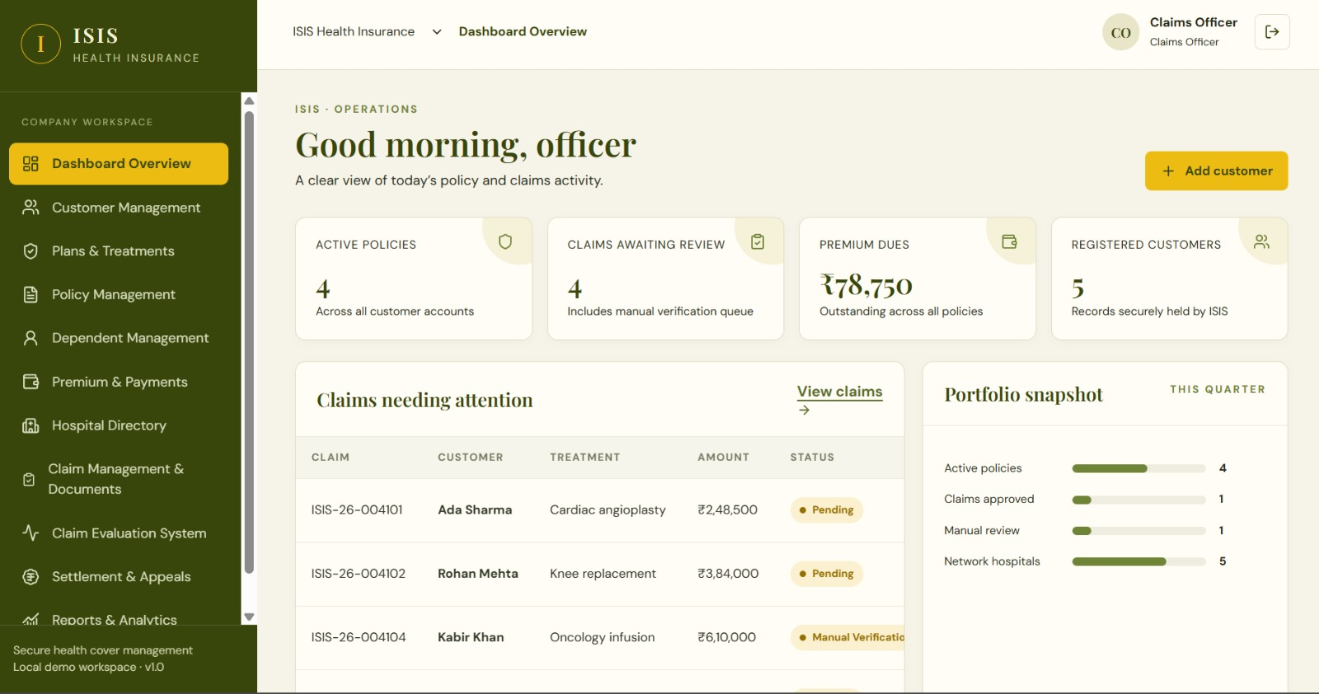
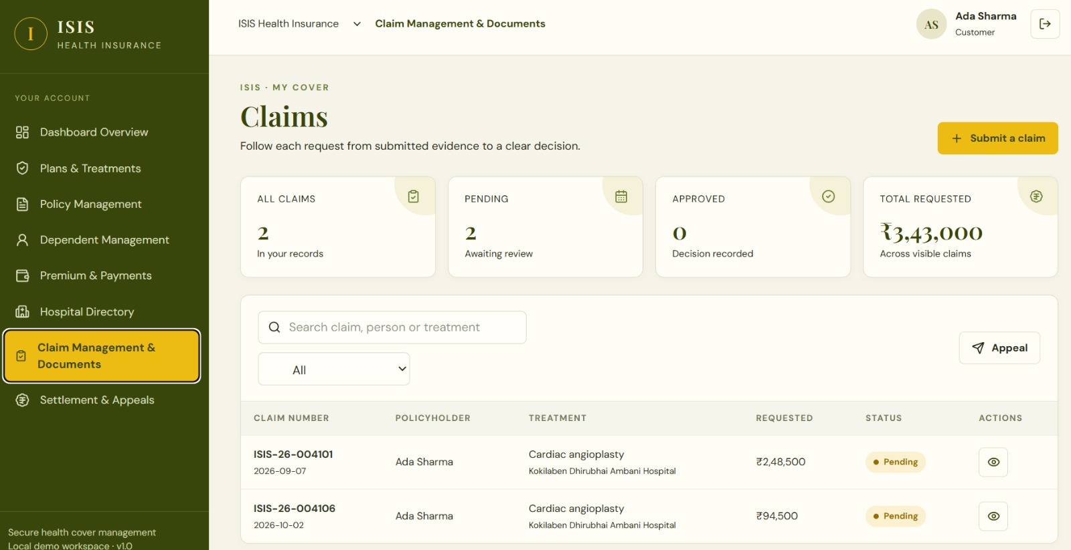
UI Demo (Live)
Flows: Insert → View → Delete → Verify in MySQL → Claim Evaluation
All UI actions persist immediately to the database
Demo screens: Dashboard, Insert form, Table view, Claim evaluation panel

Slide 9
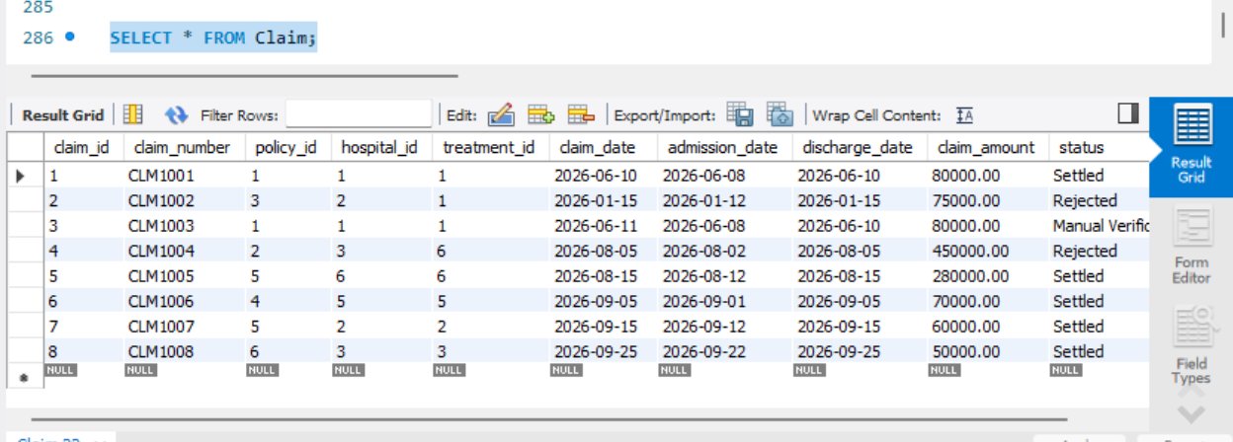
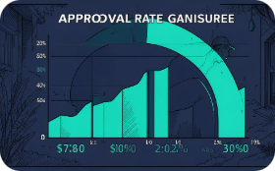
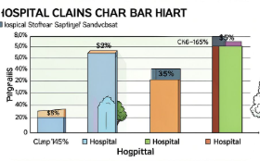
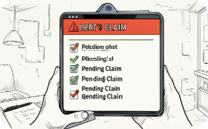

Reports & Results
Approval Rate
Hospital-wise Claims
Show trend & monthly breakdown
Top hospitals by claim volume
Pending / Manual Claims
Settlement Report
Queue for manual review
Amounts settled, pending, and rejected

Slide 10
Conclusion & Future Scope
Conclusion: Centralized DB improves integrity, traceability & reporting
Explainable decisioning reduces manual review and aids audits
Performance: efficient joins, indexed lookups, controlled transactions
Future scope: automated notifications, advanced analytics, mobile UI, fraud detection
Thank you — Questions?

